Slide 1


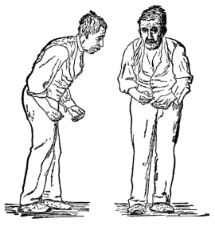
JOGINPALLY B.R. ENGINEERING COLLEGE
Accredited by NAAC A+, Recognized by UGC 2(f) Act.1956 Approved by AICTE & Affiliated TO JNTUH, Hyderabad.
Yenkapally (V), Moinabad (M), P.O. Himayat Nagar, R.R. District, Hyderabad – 500 075.
Phone: 08413-235684, 235051, Tele Fax: 08413-235125
Website: www.jbrec.edu.in, e- mail: principal@jbrec.edu.in
PRESENTED BY:
M. Sai Prasanna
S. Hemalatha
V. Praveen Kumar
T. Vinay Kumar
GUIDE NAME:
Mr. K. Praveen kumar.
Parkinson’s Disease Using Machine Learning

Slide 2
TITLE JUSTIFICATION
Parkinson's disease is a progressive disorder that affects the nervous system and the parts of the body controlled by the nerves. Symptoms start slowly. The first symptom may be a barely noticeable tremor in just one hand. Tremors are common, but the disorder may also cause stiffness or slowing of movement.
The recent report of the World Health Organization shows a visible increase in the number and health burden of Parkinson’s disease patients increases rapidly. In China, this disease is spreading so fast and estimated that it reaches half of the population in the next 10 years.
Parkinson’s disease is the second most dangerous neurological disorder that can lead to shaking, shivering, stiffness, and difficulty walking and balance.

Slide 3
ABSTRACT
In various data repositories, there are large medical datasets available that are used to identifying the diseases. Parkinson’s is considered one of the deadliest and progressive nervous system diseases that affect movement.
It is the second most common neurological disorder that causes disability, reduces the life span, and still has no cure.
Nearly 90% of affected people with this disease have speech disorders. In real-world applications, the information is been generated by using various Machine Learning techniques.

Slide 4
Cont..
Machine learning algorithms help to generate useful content from it. To increase the lifespan of elderly people the machine learning algorithms are used to detect diseases in the early stages. Speech features are the main concept while taking into consideration the term ‘Parkinson’s’.
Using various Machine Learning techniques like KNN, Naive Bayes, and Logistic Regression and how these algorithms are used to predict Parkinson’s based on the input taken from the user and the input for algorithms is the dataset.
The accuracies obtained for the three algorithms are KNN with 80%, Logistic Regression with 79%, and Naive Bayes with the highest accuracy of 81% and it is used in the frontend to predict whether the patient has Parkinson’s is present or not.

Slide 5
DOMAIN INTRODUCTION
Machine Learning:
Splitting the dataset into Training set and testing set: In machine learning data preprocessing, we have to break our dataset into both training set and test set.
This is often one among the crucial steps of knowledge preprocessing as by doing this, we will enhance the performance of our machine learning model. Suppose, if we've given training to our machine learning model by a dataset and that we test it by a totally different dataset. Then, it'll create difficulties for our model to know the correlations between the models. If we train our model alright and its training accuracy is additionally very high, but we offer a replacement dataset there to, then it'll decrease the performance. So we always attempt to make a machine learning model which performs well with the training set and also with the test dataset.

Slide 6
Cont..
Usually, we split the dataset into train and test in the ratio of 7:3 i.e., 70 percent of data is used for training and 30 percent of data is used for testing the model.

Slide 7
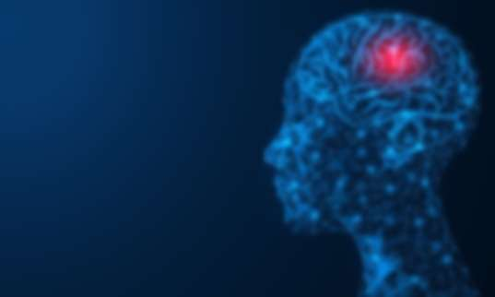
EXISTING SYSTEM
Software:
  Spyder
  Google Colab
Operating System: Windows 10
Tools: Web Browser
Python Libraries: numpy, pandas, matplotlab, seaborn, sklearn, pickle.

Slide 8
EXISTING SYSTEM DISADVANTAGES
More man power.
Time Consuming.
Consumes large volume of paper work.

Slide 9
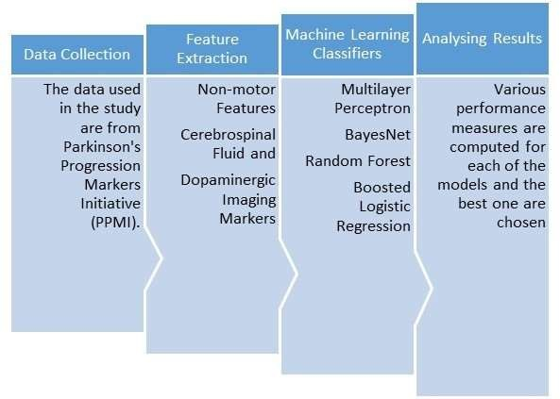
PROPOSED SYSTEM

Slide 10
PROPOSED SYSTEM ADVANTAGES
They judge the software supported Responsiveness, Usability, Security, Portability, and other non-functional standards that are critical to the success of the software.
  Accuracy
  Reliability
  Flexibility

Slide 11


